Slide 1






Retek Inc.
Supply Chain Execution
January 13, 2003

Slide 2
Retek’s Enterprise Ready Point Solutions
Merchandise Optimization & Planning
Merchandise
Planning
Assortment
Planning
Item
Planning
Visual Space
Planning
Promotional
Planning
Markdown
Optimization
Price
Optimization
Assort to Space
Optimization
Customer
Optimization
Merchandise Operations
Management
Merchandise Management:
-Item -Promotion -PO Mgmt
-Vendor -Price & Cost -Import
-Replenishment -Stock Ledger -Inventory
Sales
Audit
Rules Based
Pricing
Invoice
Matching
Collaborative
Design & Source
Inventory Optimization & Planning
Demand
Planning
Replenishment
Planning
Allocation
Planning
Inventory
Optimization
CPFR
VMI
Supply Chain Execution
Warehouse
Management
Labor & Operations
Management
Transportation
Management
DC
Labor Scheduling
Integrated Store Operations
Point of
Sale
Store
Back Office
Order
Management
Service
Optimization
Time &
Attendance
Enterprise Infrastructure
Data
Warehouse
Alerts &
Workflow
Workbench
Integration
Bus
’03 Release
Solutions
Delivery
Consulting
Training
Custom
Development
Customer
Support

Slide 3
Solution Strategy
Real-Time Synchronization
Merchandise
Optimization
& Planning
Merchandise
Operations
Management
Integrated
Store
Operations
Demand
Planning
Inventory
Optimization
& Planning
Supply
Chain
Execution
Enterprise Infrastructure

Slide 4
Supply Chain Execution
Reducing and controlling the COGS has a significant impact on a retailers bottom-line (% of sales)
Factory to Port
Intl Shipping
Storage/Demurrage
Domestic Inbound
Processing / VAS
DC/Warehouse
Domestic Outbound
Inventory Finance
TOTAL
Distribution: 2.1 – 3.4%
Transportation: 1.9 – 3.0%
Source:
IMRA
    4 – 6%
Percentage of Sales
Notes:
The cost of moving product from the supplier to to the store represents, on average, 4-6% of retail sales
@ 50% margin this is 8-12% of the cost of goods (COG)
May be as high as 28% for import merchandise
US Industry is overpaying customs by $5 B annually
Retek delivers solutions to help return a reduced COGS.

Slide 5
Supply Chain Execution
The combination of key performance enablers and a flexible warehouse transaction system delivers performance improvement by enabling realization of value opportunities
Performance Improvement
Improved
Management
Measures & Controls
Turning Data into Information
Optimization within Execution
Visibility
and Collaborative Execution
Improved Processes & Methods
Flexible Warehouse Transaction System
Notes:
High Performance Execution => a flexible Supply Chain foundation linked with 3 Performance Enablers.
Visibility & Collaborative Execution involves improving what you can control through improved visibility throughout the supply chain.
Optimization within Execution utilizes technology to improve performance.
And Turning Data into Information delivers meaningful, accessible data.

Slide 6
Supply Chain Execution
A continuous improvement process drives consistent realization of value opportunities
Plan
Optimize
Execute
Analyze
Modify
Continuous Improvement
Turning Data into Information
Optimization within Execution
Visibility
and Collaborative Execution
Flexible Warehouse Transaction System
Notes:
High Performance Execution is focused on supporting the 5-step continuous improvement process, which is why the flexible supply chain foundation is so important.

Slide 7
Supply Chain Execution
Retek’s Supply Chain strategy combines performance enablers with a flexible foundation to deliver continuous improvement and value realization
Objective
Continuous Improvement
Turning
Optimization
Visibility and
Data into
within
Collaborative
Information
Execution
Execution
Improved Mgmt & Controls
•
Labor
•
Labor Standards
•
POs & Invoicing
Management
•
SKU Profiling
•
Advanced Ship
•
Labor Reporting
•
Dynamic
Notices (ASN)
•
Operations
Optimizers
•
Integration (RIB)
Management
•
Active Retail
•
VQM
Intelligence (ARI)
•
Yard/Appt Sched
Flexible Warehouse Transaction System
Improved Processes & Methods
•
Foundation Basics
•
User-defined Processes
•
Foundation Processing
•
Work Directives
•
Units of Measure
•
Performance Measures
•
Item Configuration
•
Multiple Mode-of-Flow

Slide 8



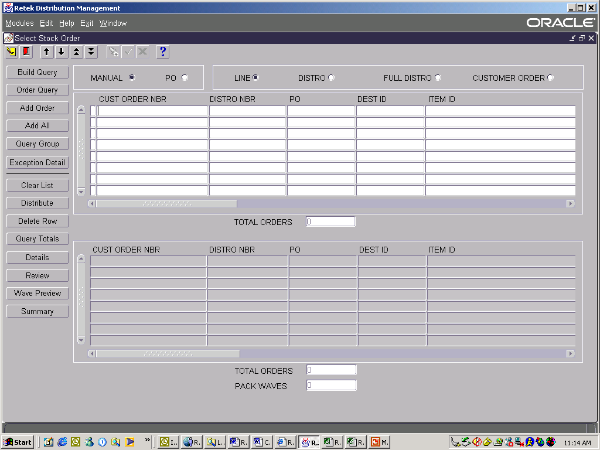

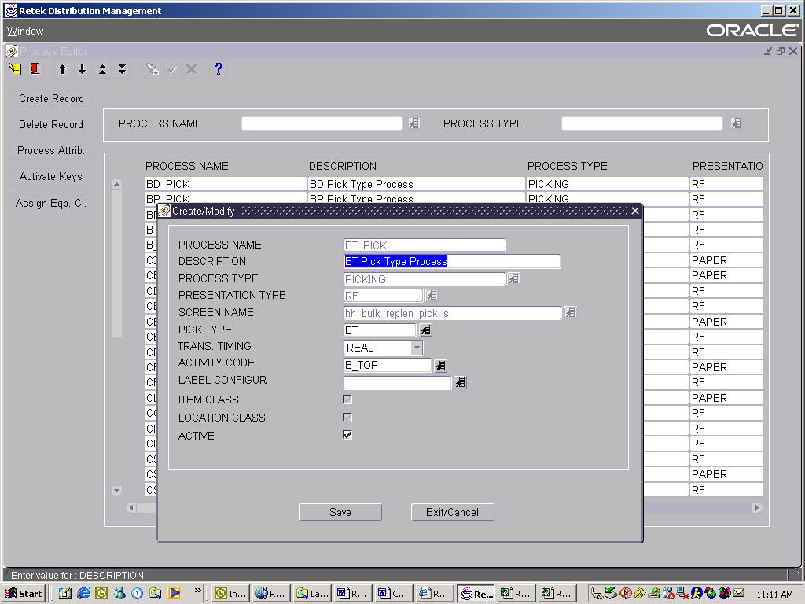
Retek Distribution Management
Capabilities
User-defined Process Definition
Yard Management / Appointment Scheduling
Receiving, Putaway & inventory Management
Wave Planning, Picking & Replenishment
Shipping & Trailer Tracking
Multi-channel, multi-vertical, and multi-country operations
Task Management
Cross-docking & Flow Through
Insert
Screen
Shots of
RMS 10
Value Delivered
Reduce inventories by 5-10%
Reduce lead times by 10%
Increase productivity by 20-30%
Notes:
Enter on:
Retek Merchandising delivers coordinated operations and one version of the truth. It’s about providing the right product, at the right place, at the right time, and at the right price. Retek’s suite of merchandising solutions links the customer execution layer with the supply chain and fulfillment processes to drive and manage demand. The result is increased sales, higher gross margin, reduced inventories, and fewer markdowns.
Supporting Content:
Retek’s Merchandising solutions include:
Integrated Merchandising – End-to-end merchandising that supports multi-channel operations with an integrated, scalable data infrastructure. This is the backbone that enables real-time inventory tracking.
Assortment & Space Optimization – the ability to leverage core business information to optimize the assortment and presentation of merchandise at a sku/store level, driving improved service levels and lower inventory
Price Optimization – Merchants are able to analyze and execute optimized pricing strategies easily and efficiently. Includes business constraints and goals to drive targeted price points based on markdown, price relationships and competitive pricing. The system then monitors and recommends changes to the strategy
Promotion Effectiveness – Provides insight into promotional effectiveness and predicts promotional impact to sales and inventory, incorporating key factors such as lift, drag, and cannibalization.
Examples:
Future Shop – Vancouver based Electronics retailer partnered with Retek for a complete replacement of their legacy IT infrastructure. The Business Challenge was that the old IT infrastructure simply could not efficiently handle the new volumes of data that came with store and channel expansion. Future Shop selected Retek to provide a flexible, multi-channel infrastructure and have been live since May 2000. Future shop is now reaping the benefits of integrated merchandising solution such as improved gross margins through better inventory management, reduced overhead costs by automation of business processes, enhanced customer service and competitive position. Future Shop is now enabled for growth with scalable, multi-channel foundation for expansion and data integration to support merchandising, store and warehouse operations, and customer relation management
-Gary Patterson, EVP and CFO - “(Retek)…will enable us to more effectively serve our customers and significantly reduce operating costs. More specifically, inventory, service, warranty, and returns will be managed more efficiently, ultimately allowing a significant increase in inventory turns, which is a key benchmark to any retailer. We are also expecting significant improvements in markdowns and overhead costs.” –
The Home Shopping Network is a pioneering electronic retailer with multiple selling channels; most operating continuously- twenty four hours a day, seven days a week. HSN utilizes a multi-channel strategy via its television services, web site, direct mail, and retail stores. HSN strives to meet and exceed customer expectations by providing the ultimate shopping experience that fully integrates content, community, and commerce. To provide this level of service, all of these channels needed to be managed with a single view of inventory. HSN selected Retek to meet this challenge and provide a scalable, multi-channel foundation to manage all of its retail operations.
-Irene Messier, Vice President of Inventory Management and Process Design, The Home Shopping Network: " Retek has sparked improved inventory and sales performance. Our run rate has improved 5%, and reorders are up $8 million over three months comparable to last year, after the RMS roll out."
A&P selected Retek (RMS, RDW, TopPlan, RDF, ARI) in alliance with IBM to develop a new solution to address the specific needs of the grocery industry and to build competitive advantage in inventory management
Eckerd (RMS, ARI, Store Ops, Sales Audit, RDM, RDF) "Retek will make it possible for us to quickly change our offerings and inventories to meet each store's local needs for the community they serve," says Ken Petersen, Senior Vice President and Chief Information Officer.
Fnac (RMS, ARI, RDF, RDW, RDW, RDM, Sales Audit) "We believed it was critical to build a new infrastructure that would be dependable, flexible, and support our merchandising activities across any number of channels. Retek fits perfectly into this strategy." - Jean-Francois Bourgeois, Chief Information Officer, FNAC.
Edgars (Markdown Mgmt., RMS, ARI, RDW, RDF, RTM, Invoice Matching, RDM) Integrated Merchandising for multiple fashion divisions including footwear. Reducing operating costs, improving inventory visibility and increasing service levels and profitability to their stores.
Positioning Statement: For retailers looking to drive revenue growth, improve profitability and enhance ROI, Retek Merchandising Solutions deliver rapid results to the most critical areas of your business with the foundation to continuously improve and grow your performance. Unlike non-retail point systems and traditional applications, our solutions provide real benefits to retailers through deep retail capabilities in an integrated foundation.

Slide 9


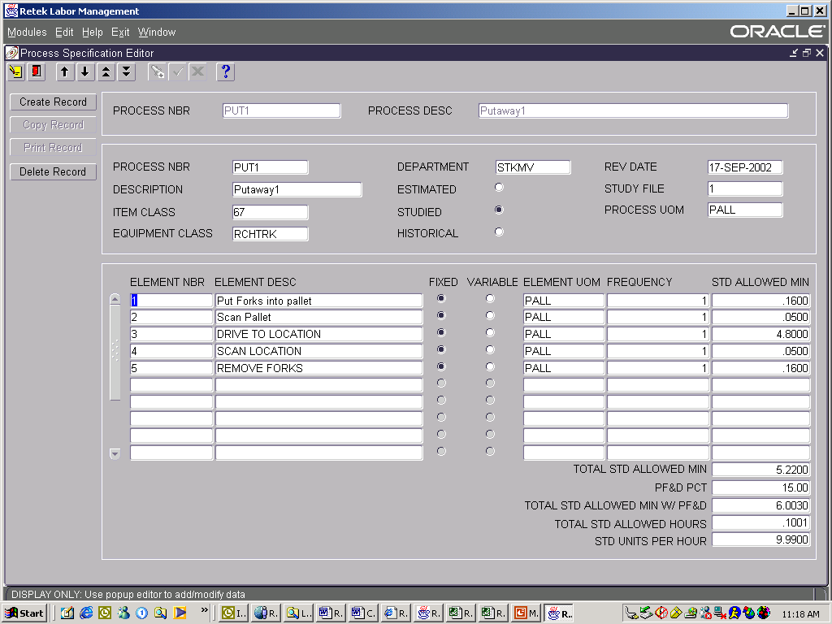
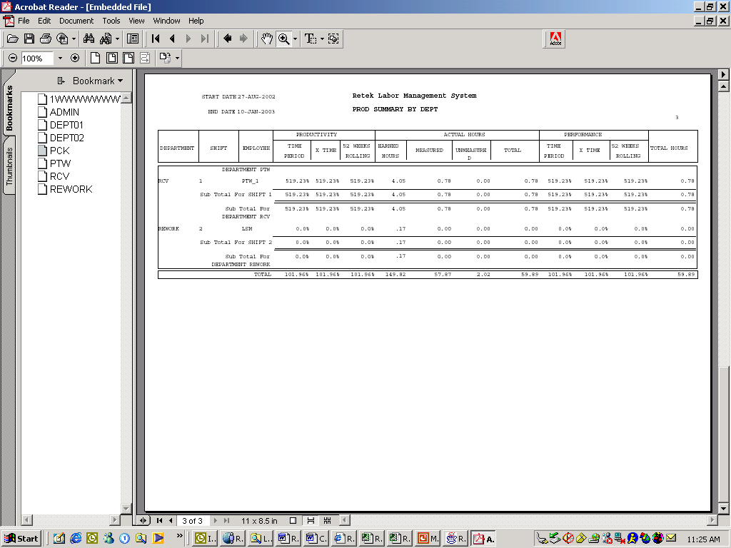
Retek Labor & Performance Management
Capabilities
Engineered Labor Standards
X – Y – Z Coordinates
Work Element Definition
Studied, Historical, and Estimated Standards
Labor Reporting
Performance Reporting
Historical Analysis
Insert
Screen
Shots of
RMS 10
Value Delivered
Reduce labor spend by 12-18%
Reduce overtime by 50-70%
Notes:
Enter on:
Retek Merchandising delivers coordinated operations and one version of the truth. It’s about providing the right product, at the right place, at the right time, and at the right price. Retek’s suite of merchandising solutions links the customer execution layer with the supply chain and fulfillment processes to drive and manage demand. The result is increased sales, higher gross margin, reduced inventories, and fewer markdowns.
Supporting Content:
Retek’s Merchandising solutions include:
Integrated Merchandising – End-to-end merchandising that supports multi-channel operations with an integrated, scalable data infrastructure. This is the backbone that enables real-time inventory tracking.
Assortment & Space Optimization – the ability to leverage core business information to optimize the assortment and presentation of merchandise at a sku/store level, driving improved service levels and lower inventory
Price Optimization – Merchants are able to analyze and execute optimized pricing strategies easily and efficiently. Includes business constraints and goals to drive targeted price points based on markdown, price relationships and competitive pricing. The system then monitors and recommends changes to the strategy
Promotion Effectiveness – Provides insight into promotional effectiveness and predicts promotional impact to sales and inventory, incorporating key factors such as lift, drag, and cannibalization.
Examples:
Future Shop – Vancouver based Electronics retailer partnered with Retek for a complete replacement of their legacy IT infrastructure. The Business Challenge was that the old IT infrastructure simply could not efficiently handle the new volumes of data that came with store and channel expansion. Future Shop selected Retek to provide a flexible, multi-channel infrastructure and have been live since May 2000. Future shop is now reaping the benefits of integrated merchandising solution such as improved gross margins through better inventory management, reduced overhead costs by automation of business processes, enhanced customer service and competitive position. Future Shop is now enabled for growth with scalable, multi-channel foundation for expansion and data integration to support merchandising, store and warehouse operations, and customer relation management
-Gary Patterson, EVP and CFO - “(Retek)…will enable us to more effectively serve our customers and significantly reduce operating costs. More specifically, inventory, service, warranty, and returns will be managed more efficiently, ultimately allowing a significant increase in inventory turns, which is a key benchmark to any retailer. We are also expecting significant improvements in markdowns and overhead costs.” –
The Home Shopping Network is a pioneering electronic retailer with multiple selling channels; most operating continuously- twenty four hours a day, seven days a week. HSN utilizes a multi-channel strategy via its television services, web site, direct mail, and retail stores. HSN strives to meet and exceed customer expectations by providing the ultimate shopping experience that fully integrates content, community, and commerce. To provide this level of service, all of these channels needed to be managed with a single view of inventory. HSN selected Retek to meet this challenge and provide a scalable, multi-channel foundation to manage all of its retail operations.
-Irene Messier, Vice President of Inventory Management and Process Design, The Home Shopping Network: " Retek has sparked improved inventory and sales performance. Our run rate has improved 5%, and reorders are up $8 million over three months comparable to last year, after the RMS roll out."
A&P selected Retek (RMS, RDW, TopPlan, RDF, ARI) in alliance with IBM to develop a new solution to address the specific needs of the grocery industry and to build competitive advantage in inventory management
Eckerd (RMS, ARI, Store Ops, Sales Audit, RDM, RDF) "Retek will make it possible for us to quickly change our offerings and inventories to meet each store's local needs for the community they serve," says Ken Petersen, Senior Vice President and Chief Information Officer.
Fnac (RMS, ARI, RDF, RDW, RDW, RDM, Sales Audit) "We believed it was critical to build a new infrastructure that would be dependable, flexible, and support our merchandising activities across any number of channels. Retek fits perfectly into this strategy." - Jean-Francois Bourgeois, Chief Information Officer, FNAC.
Edgars (Markdown Mgmt., RMS, ARI, RDW, RDF, RTM, Invoice Matching, RDM) Integrated Merchandising for multiple fashion divisions including footwear. Reducing operating costs, improving inventory visibility and increasing service levels and profitability to their stores.
Positioning Statement: For retailers looking to drive revenue growth, improve profitability and enhance ROI, Retek Merchandising Solutions deliver rapid results to the most critical areas of your business with the foundation to continuously improve and grow your performance. Unlike non-retail point systems and traditional applications, our solutions provide real benefits to retailers through deep retail capabilities in an integrated foundation.

Slide 10
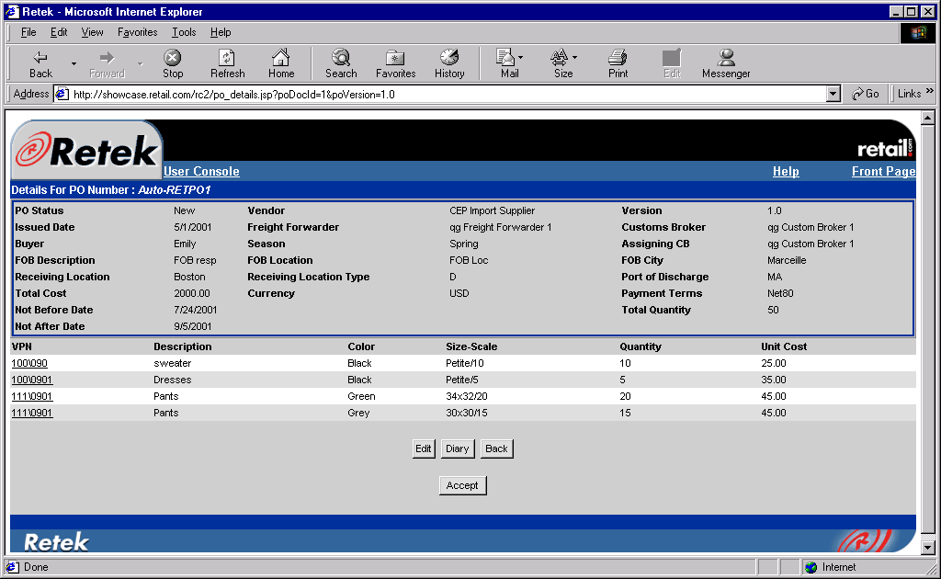
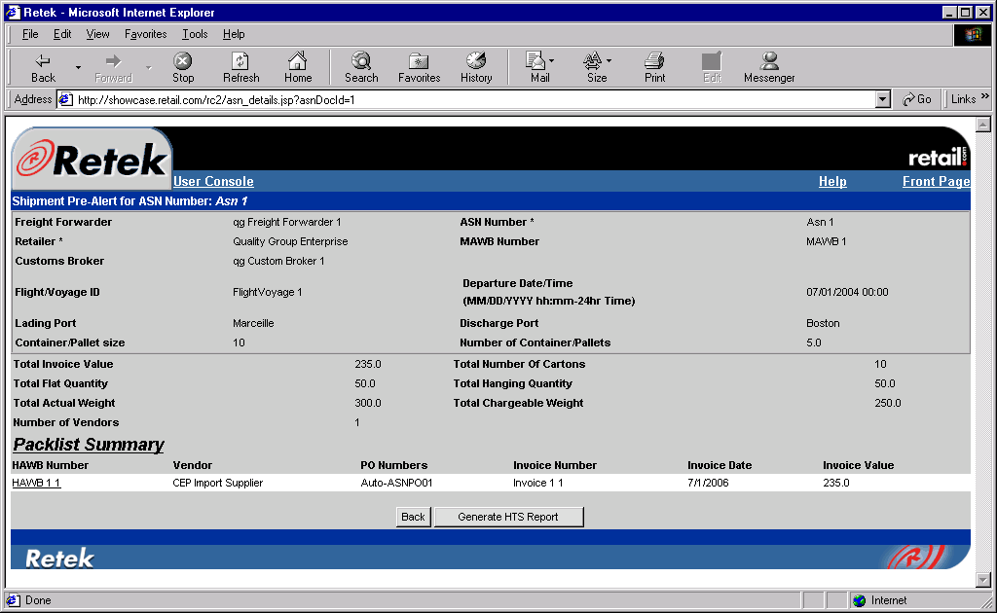
Retek RetailCommerce
Capabilities
Collaborative Trading Platform
  Purchase Order Management
  Invoicing / Self-invoicing
  Advanced Shipment Notice (ASN)
Harmonized Tariff Schedule
Audit Trails and Diary Entries
Secure Transactions
PO Visibility
Insert
Screen
Shots of
RMS 10
Value Delivered
Reduced Lead Times
Reduce Data Entry
Increased Receipt Accuracy
Reduced Receiving Exceptions
Notes:
Enter on:
Retek Merchandising delivers coordinated operations and one version of the truth. It’s about providing the right product, at the right place, at the right time, and at the right price. Retek’s suite of merchandising solutions links the customer execution layer with the supply chain and fulfillment processes to drive and manage demand. The result is increased sales, higher gross margin, reduced inventories, and fewer markdowns.
Supporting Content:
Retek’s Merchandising solutions include:
Integrated Merchandising – End-to-end merchandising that supports multi-channel operations with an integrated, scalable data infrastructure. This is the backbone that enables real-time inventory tracking.
Assortment & Space Optimization – the ability to leverage core business information to optimize the assortment and presentation of merchandise at a sku/store level, driving improved service levels and lower inventory
Price Optimization – Merchants are able to analyze and execute optimized pricing strategies easily and efficiently. Includes business constraints and goals to drive targeted price points based on markdown, price relationships and competitive pricing. The system then monitors and recommends changes to the strategy
Promotion Effectiveness – Provides insight into promotional effectiveness and predicts promotional impact to sales and inventory, incorporating key factors such as lift, drag, and cannibalization.
Examples:
Future Shop – Vancouver based Electronics retailer partnered with Retek for a complete replacement of their legacy IT infrastructure. The Business Challenge was that the old IT infrastructure simply could not efficiently handle the new volumes of data that came with store and channel expansion. Future Shop selected Retek to provide a flexible, multi-channel infrastructure and have been live since May 2000. Future shop is now reaping the benefits of integrated merchandising solution such as improved gross margins through better inventory management, reduced overhead costs by automation of business processes, enhanced customer service and competitive position. Future Shop is now enabled for growth with scalable, multi-channel foundation for expansion and data integration to support merchandising, store and warehouse operations, and customer relation management
-Gary Patterson, EVP and CFO - “(Retek)…will enable us to more effectively serve our customers and significantly reduce operating costs. More specifically, inventory, service, warranty, and returns will be managed more efficiently, ultimately allowing a significant increase in inventory turns, which is a key benchmark to any retailer. We are also expecting significant improvements in markdowns and overhead costs.” –
The Home Shopping Network is a pioneering electronic retailer with multiple selling channels; most operating continuously- twenty four hours a day, seven days a week. HSN utilizes a multi-channel strategy via its television services, web site, direct mail, and retail stores. HSN strives to meet and exceed customer expectations by providing the ultimate shopping experience that fully integrates content, community, and commerce. To provide this level of service, all of these channels needed to be managed with a single view of inventory. HSN selected Retek to meet this challenge and provide a scalable, multi-channel foundation to manage all of its retail operations.
-Irene Messier, Vice President of Inventory Management and Process Design, The Home Shopping Network: " Retek has sparked improved inventory and sales performance. Our run rate has improved 5%, and reorders are up $8 million over three months comparable to last year, after the RMS roll out."
A&P selected Retek (RMS, RDW, TopPlan, RDF, ARI) in alliance with IBM to develop a new solution to address the specific needs of the grocery industry and to build competitive advantage in inventory management
Eckerd (RMS, ARI, Store Ops, Sales Audit, RDM, RDF) "Retek will make it possible for us to quickly change our offerings and inventories to meet each store's local needs for the community they serve," says Ken Petersen, Senior Vice President and Chief Information Officer.
Fnac (RMS, ARI, RDF, RDW, RDW, RDM, Sales Audit) "We believed it was critical to build a new infrastructure that would be dependable, flexible, and support our merchandising activities across any number of channels. Retek fits perfectly into this strategy." - Jean-Francois Bourgeois, Chief Information Officer, FNAC.
Edgars (Markdown Mgmt., RMS, ARI, RDW, RDF, RTM, Invoice Matching, RDM) Integrated Merchandising for multiple fashion divisions including footwear. Reducing operating costs, improving inventory visibility and increasing service levels and profitability to their stores.
Positioning Statement: For retailers looking to drive revenue growth, improve profitability and enhance ROI, Retek Merchandising Solutions deliver rapid results to the most critical areas of your business with the foundation to continuously improve and grow your performance. Unlike non-retail point systems and traditional applications, our solutions provide real benefits to retailers through deep retail capabilities in an integrated foundation.

Slide 11
Case Study – Sheetz
Compared to what I’ve seen in my past experiences in food industry logistics, the key to our success was the great support we got from Retek, especially during the implementation phase.”
Sheetz Profile
276 Convenience Stores
2,500 Active SKUs
Sales of approximately $1.9 billion
Double digit growth plans
Major Benefits
Increased service level to 99.8%
Improved miss-ship rate to 1 in 10,000
Improved order accuracy levels
Higher margins
Improved management of inventory in the supply chain
“We work with more than 10 different software vendors, and for the most part I would say that Retek has risen to the top and has been our most stable software solution. Retek has also integrated very easily with our other systems. We see ourselves as long-term partners with Retek because they understand our business and have helped us to execute our vision.”

Slide 12
Case Study – Abercrombie & Fitch
“Youth-oriented apparel retailer Abercrombie & Fitch Co. said second-quarter earnings rose 24 percent, helped by tight inventory control and improved productivity at its distribution center.”
Abercrombie Profile
500 Apparel Stores
Sales of approximately $1.5 billion
750,000 sq. ft. Distribution Center
Productivity at the distribution center rose 67 percent when measured in units processed per labor hour. At the same time, leaner inventories helped the company limit markdowns.
"Their price integrity and their inventory management has been really excellent," said Jennifer Black, retail analyst at Wells Fargo Securities who has a "buy" rating on the stock. Inventory was down about 9 percent per square foot in the quarter, the company said.
Major Benefits
Increased productivity by 67%
Reduced inventory by 9%
Improved management of inventory in the supply chain

Slide 13
Summary
The combination of a flexible transaction foundation with key performance enablers delivers the ability to consistently realize value opportunities through continuous improvement
Plan
Optimize
Execute
Analyze
Modify
Continuous Improvement
Turning Data into Information
Optimization within Execution
Visibility
and Collaborative Execution
Flexible Warehouse Transaction System
Notes:
High Performance Execution is focused on supporting the 5-step continuous improvement process, which is why the flexible supply chain foundation is so important.

